Slide 1

Introduction to Computer Science
By Mohamed Essam
mhmd96.essam@gmail.com

Slide 2
Contents of this Course
Here’s what you’ll find in this Course:
Introduction to computing.

Slide 3
How Computer Represent Letters
ASCII stands for American Standard Code for Information Interchange.
The ASCII table contains letters, numbers, control characters, and other symbols. Each character is assigned a unique 7-bit code

Slide 4
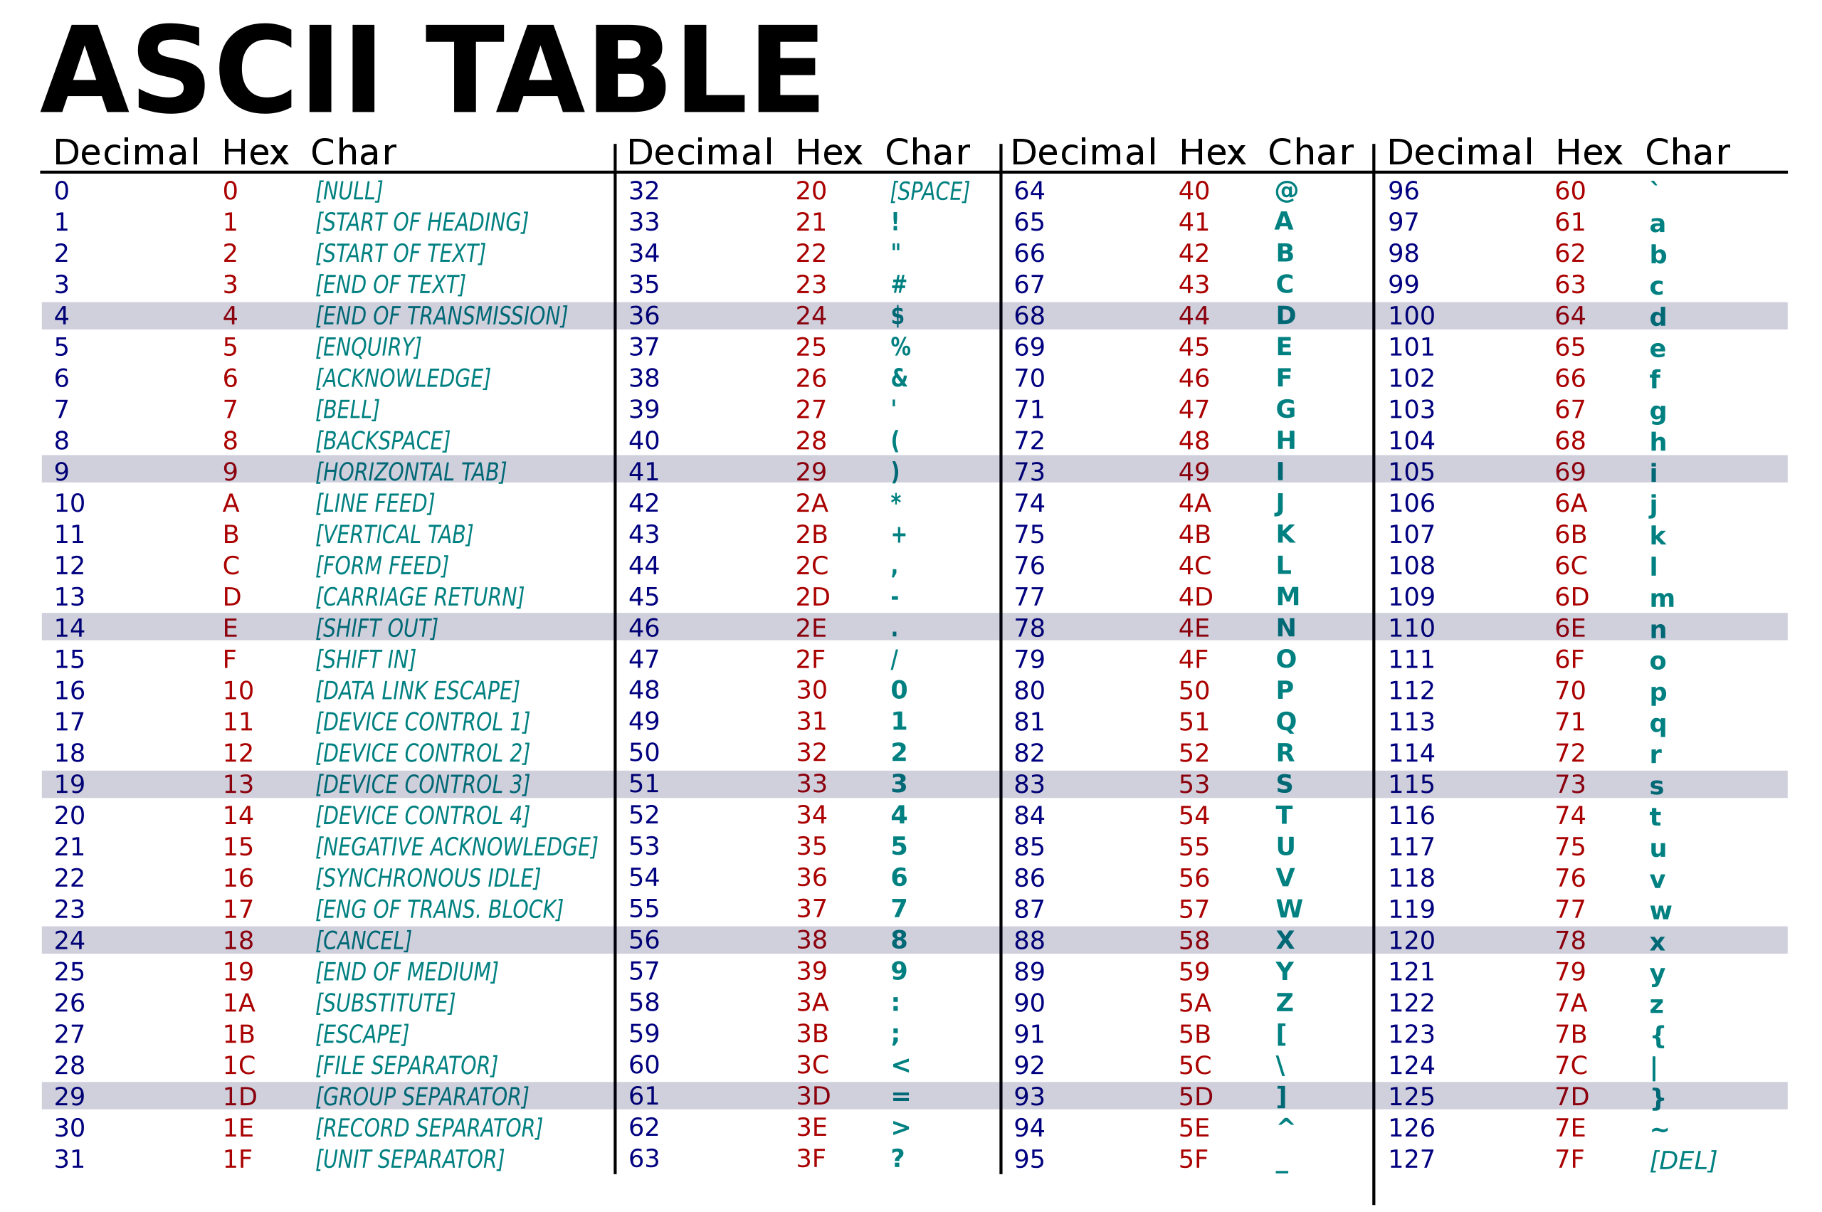

Slide 5



How Computer Represent Colors
72 73 33

Slide 6

How Computer Represent Colors
72 73 33

Slide 7

How Computer Represent images

Slide 8

How Computer Represent images

Slide 9

How Computer Represent images

Slide 10
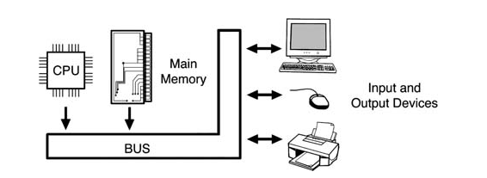
COMPUTER ARCHITECTURE
Having looked at all the parts of a computer system, now open the case of the computer to see what’s inside and to learn how it works.

Slide 11
COMPUTER ARCHITECTURE
At the left of the diagram is the central processing unit or CPU. This is the device that actually performs the computing tasks. In a sense, the CPU is the computer. Some people even refer to the entire computer case and everything inside of it as the CPU, but that’s not accurate. CPUs are often simply called processors, although processors can be used outside of the “central” role of a computer.

Slide 12
COMPUTER ARCHITECTURE
Having looked at all the parts of a computer system, now open the case of the computer to see what’s inside and to learn how it works.

Slide 13
COMPUTER ARCHITECTURE
On the right of the diagram you’ll see the kinds of devices discussed in Chapter 2: keyboard, mouse, monitor, printer, hard drive, CD-ROM drive, and so on. The CPU, main memory, and all the other devices are connected by an electrical path called the bus. Like a city bus, this bus is a shared resource, too. If you were to get on a bus at First Avenue and plan to get off at Tenth Avenue, you’d have to sit through all the stops in between. Likewise, a computer bus carries traffic to and from all the devices that are connected. Mostly this means data traveling to and from the CPU, but in some cases data travels directly from one device to another without involving the CPU.

Slide 14
Main Memory
The main memory in a computer is made of RAM, which stands for Random Access Memory. The term “random access” means that the data in the memory can be accessed in any order.
RAM is made of capacitors, which are devices that store small electrical charges. Each capacitor stores one bit. If the capacitor is mostly charged, it’s considered a 1 bit, and if it’s close to empty, it’s a 0.

Slide 15
Main Memory
RAM is divided into cells of memory called words, which may be a single byte (eight bits) or multiple bytes. Each word’s location in RAM is specified by a unique address, which is just a whole number that starts from 0. For example, if a computer system has 256 megabytes of RAM, then it has 268,435,456 bytes

Slide 16
Computer Operation
When a user requests the execution of a program, the computer brings the program from where it is stored (usually the hard drive) into main memory. Any temporary data the program needs is also stored in main memory. Storing the programs and data in main memory is necessary because storage devices like hard drives are very slow compared to the CPU. The main memory acts as a temporary “scratch pad” where the currently active program and data can be kept for quick access.

Slide 17

Computer Operation
The previous discussion assumes the operating system is already running so that the user has a way to select a program to run. But what starts the operating system? At first it seems like a chicken-and-egg problem. If the operating system is used to tell the computer what program to run next and the operating system is itself a program, what tells the computer to run anything when it’s first turned on?

Slide 18
Computer Operation
The process by which a computer starts and executes the operating system is called
booting. This is short for “bootstrapping,” which means to lift oneself up by one’s own

Slide 19
Computer Operation
The secret ingredient is called the BIOS, which stands for Basic Input/Output System. This is a set of small programs stored in ROM. Recall that ROM, as in CD-ROM, means read-only memory. Here it refers to memory that is accessed like RAM but is “hard-wired”; that is, it can’t be changed.

Slide 20

Computer Operation
When a computer’s power is turned on, the BIOS acts like a drill sergeant waking up the troops. It initializes all the devices in the system and performs some self-diagnostic tests.
Then it performs its most important task, which is loading the operating system.

